Slide 1
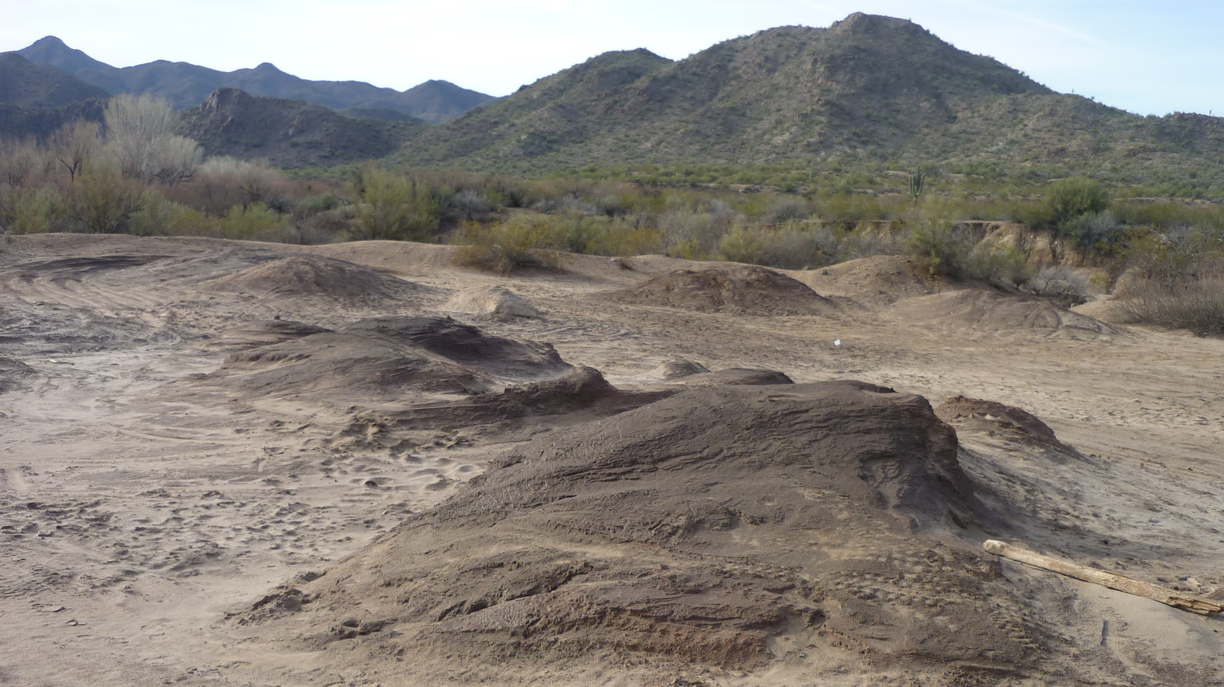



Signal Mill Preliminary Assessment/Site Investigation
Angelina Cruse, Wyatt La Fave, Anna Gorman, Ali Husain

Slide 2
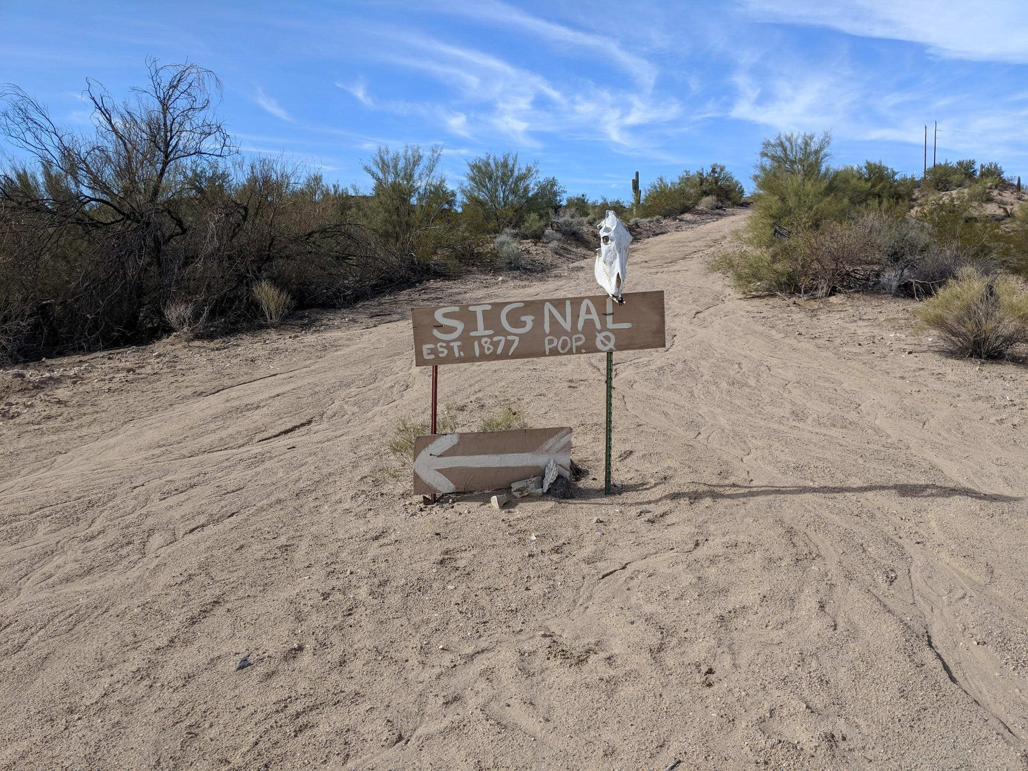
Project Introduction
Client: Bureau of Land Management (BLM)
Background: Signal Mill was a stamp mill used to process ores from the McCracken Mine.
Stamp mill: A machine that crushes ores by pounding instead of grinding.
Purpose: To provide the BLM with a Preliminary Assessment/Site Investigation (PA/SI) report, the first step of the Comprehensive Environmental Response, Compensation, and Liability Act (CERCLA) process to remediate Signal Mill [1].
Figure 1. Population of the Town of Signal
1

Slide 3
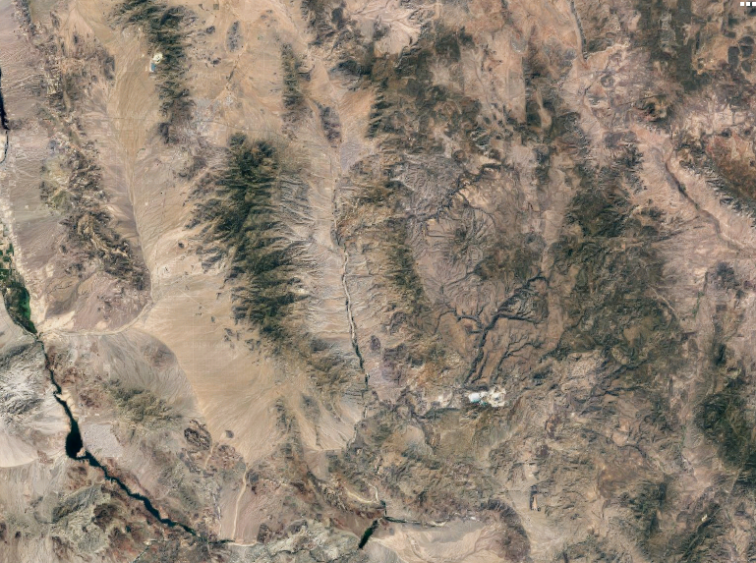

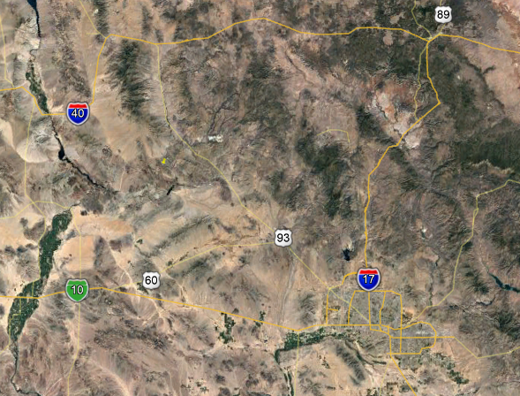

Location
Kingman
Signal Mill
Phoenix
Flagstaff
Figure 2. Location of Signal Mill.
2

Slide 4
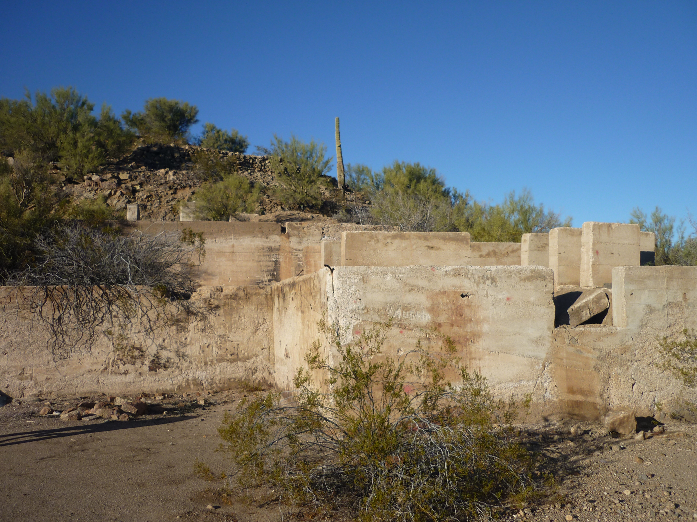
Work Plan
Development of Sampling and Analysis Plan
  Sampling procedure
  Lab analysis procedure
  Proper documentation
Development of Health and Safety Plan
  Ensures health and safety on site
  Emergency response procedure
Figure 3. Rundown Structure at Signal Mill
3

Slide 5
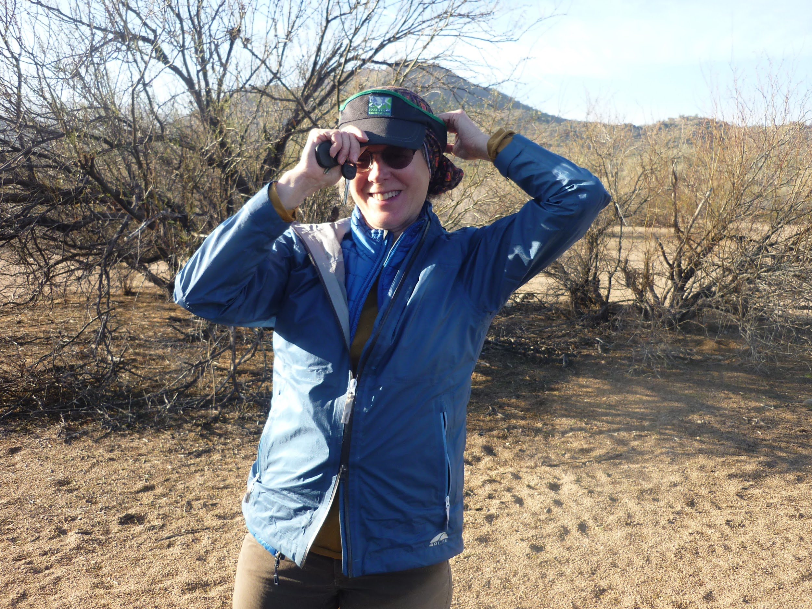
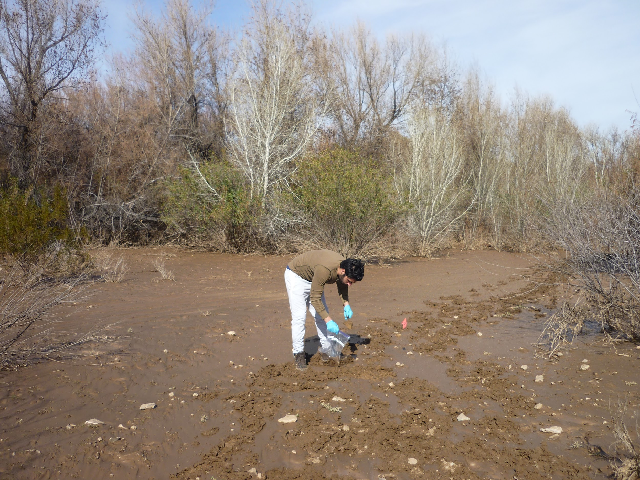
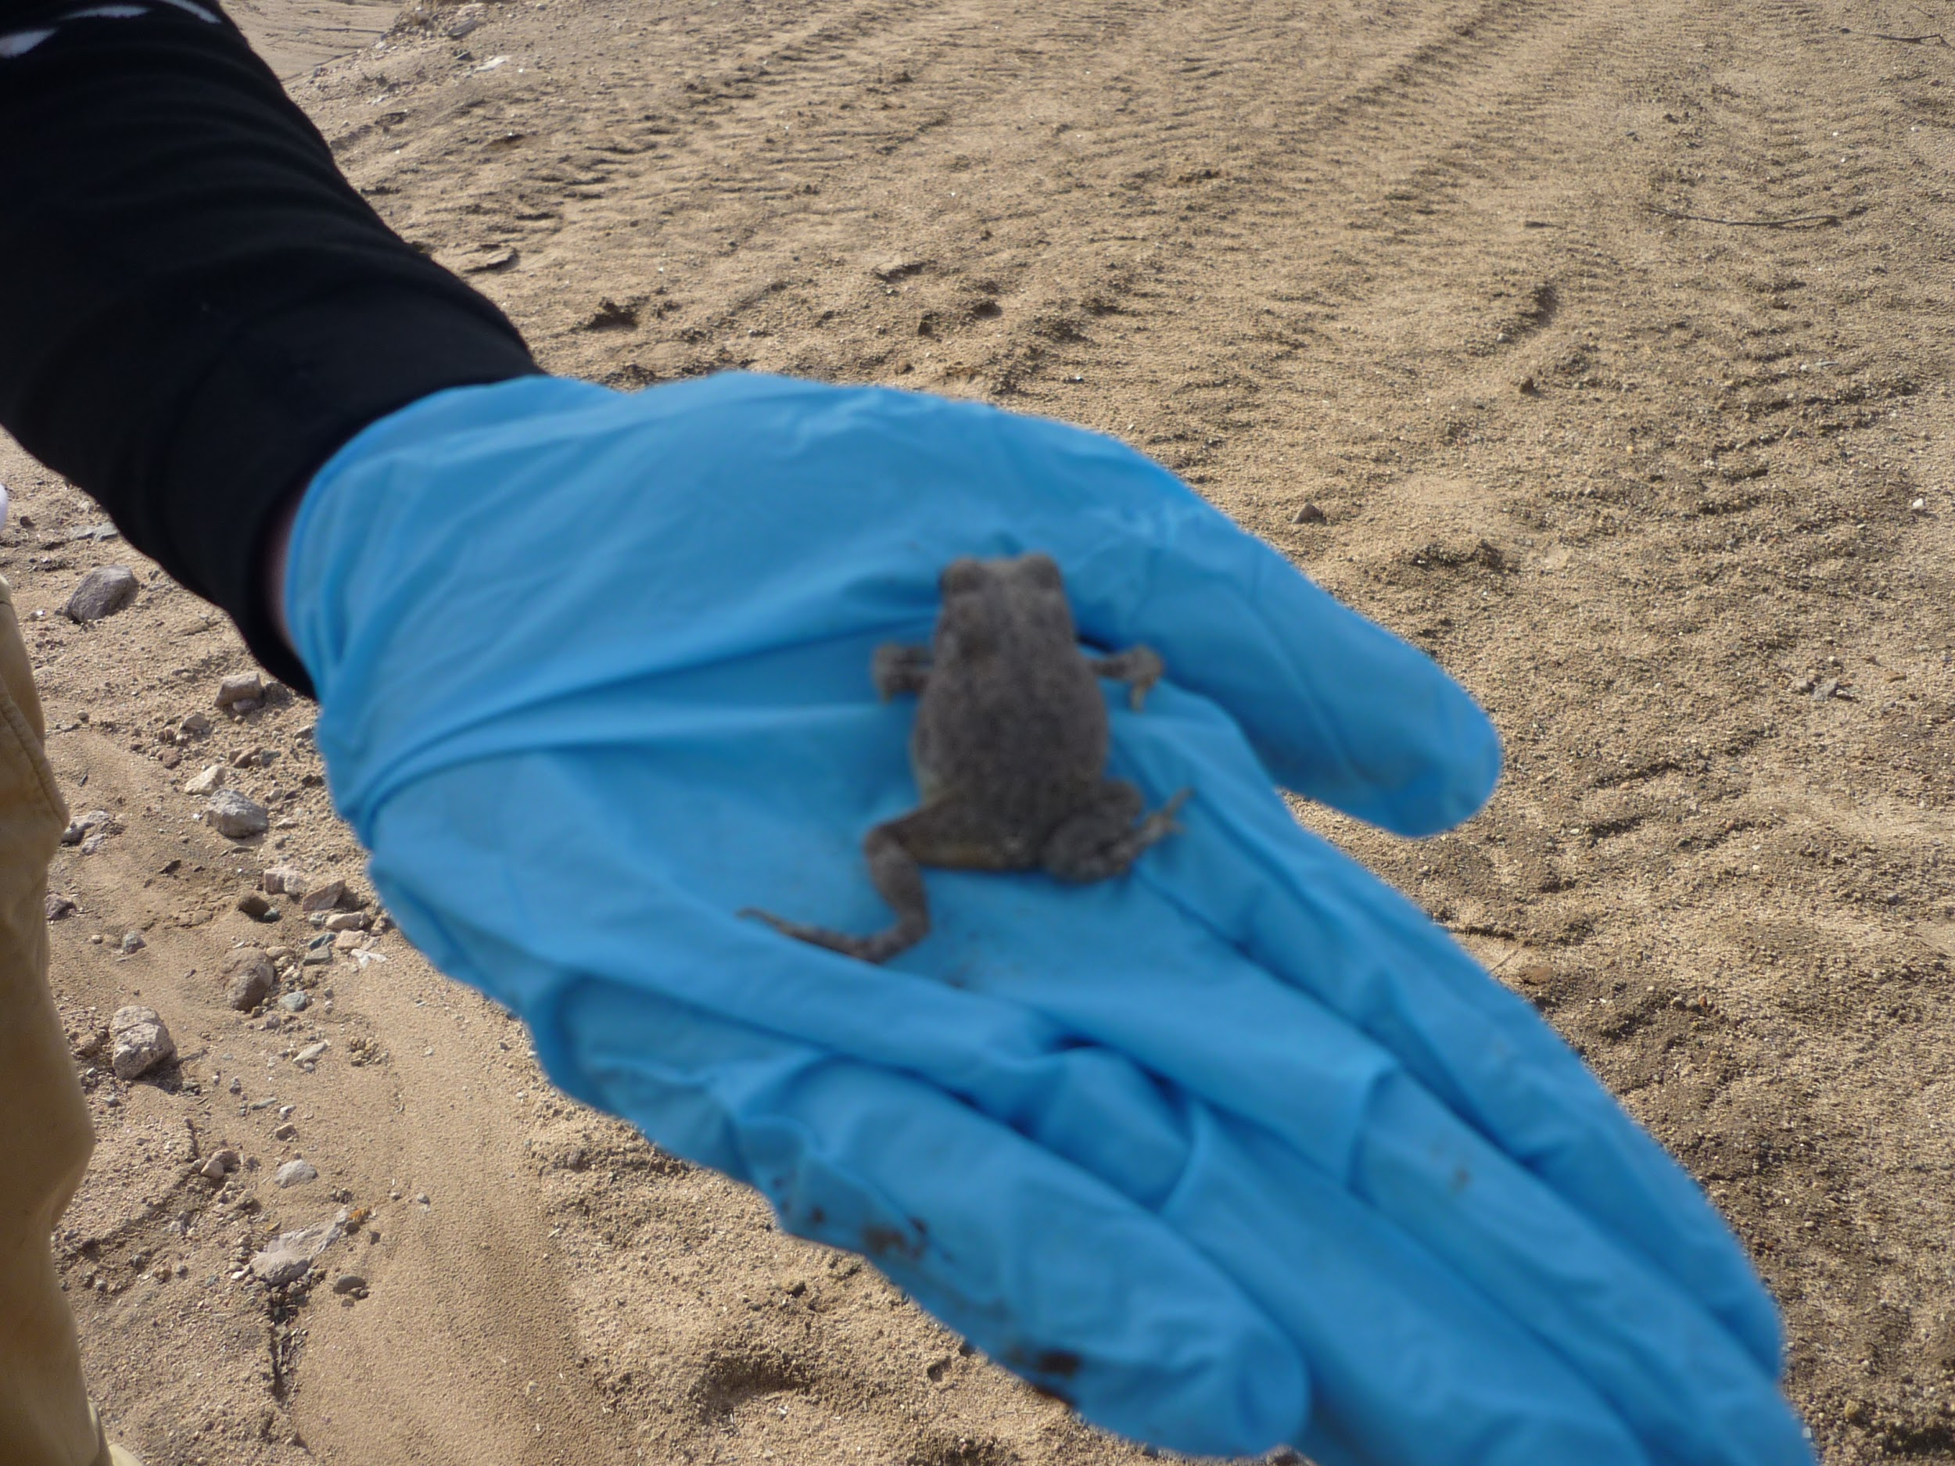
Field Sampling
Sampling occurred
January 18 - 19, 2019
82 soil samples collected
  3 Background
  5 Hotspot
  74 grid samples
Flora and Fauna Survey Completed on Site
Figure 4. Preparing for sampling.
Figure 5. Soil sampling
Figure 6. Frog found on site
4

Slide 6
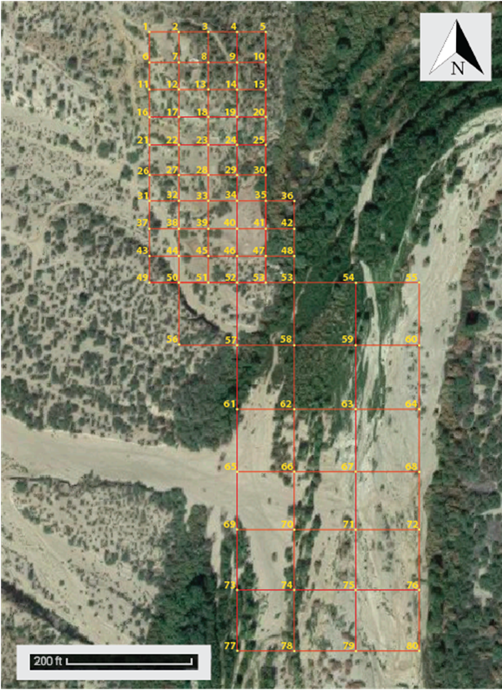
Signal Mill
Excluded Samples
Direction of Flow
Figure 7. Original Sampling Grid.
Figure 8. Sampling Grid Showing Excluded Samples.
5

Slide 7
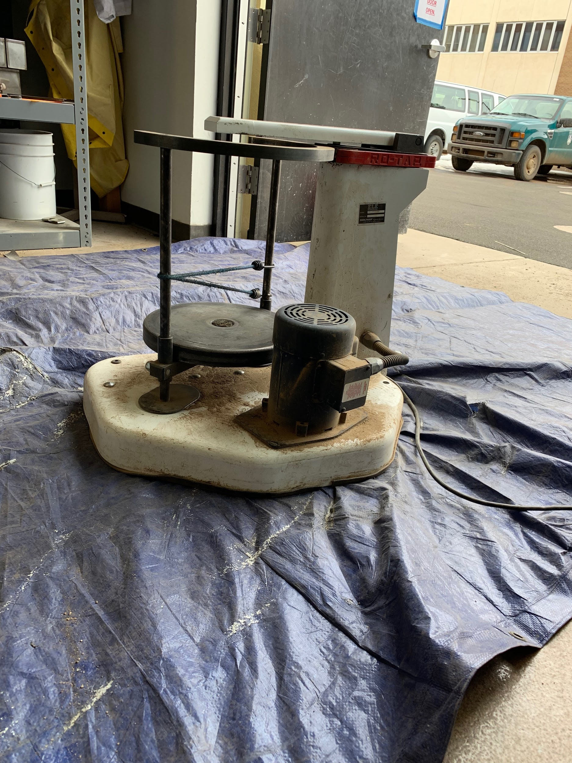
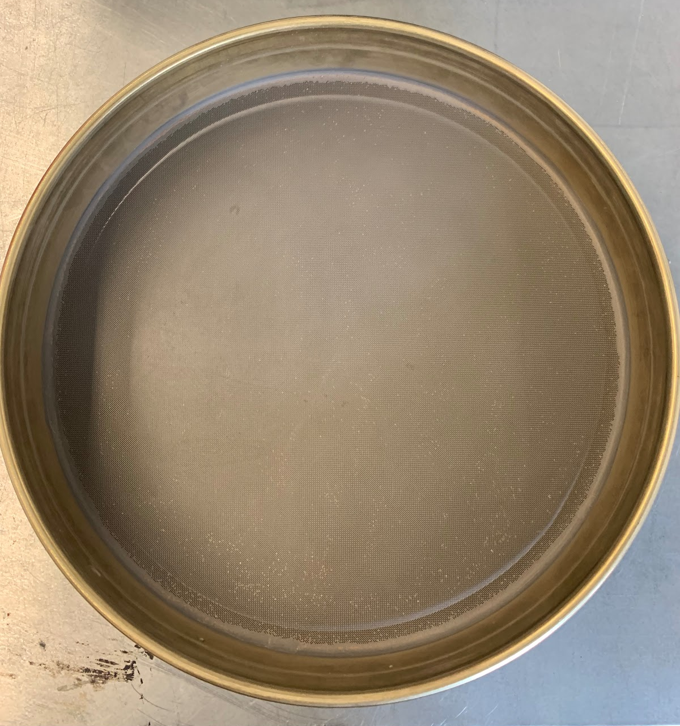
Drying and Sieving
Each sample was oven dried at 60 ℃ to prevent loss of mercury (EPA Method 200.8) [1].
Samples are sieved to the No. 40 sieve (deviation from EPA method 6200) [2].
Figure 9. Mechanical Shaker
Figure 10. No. 40 Sieve
6

Slide 8
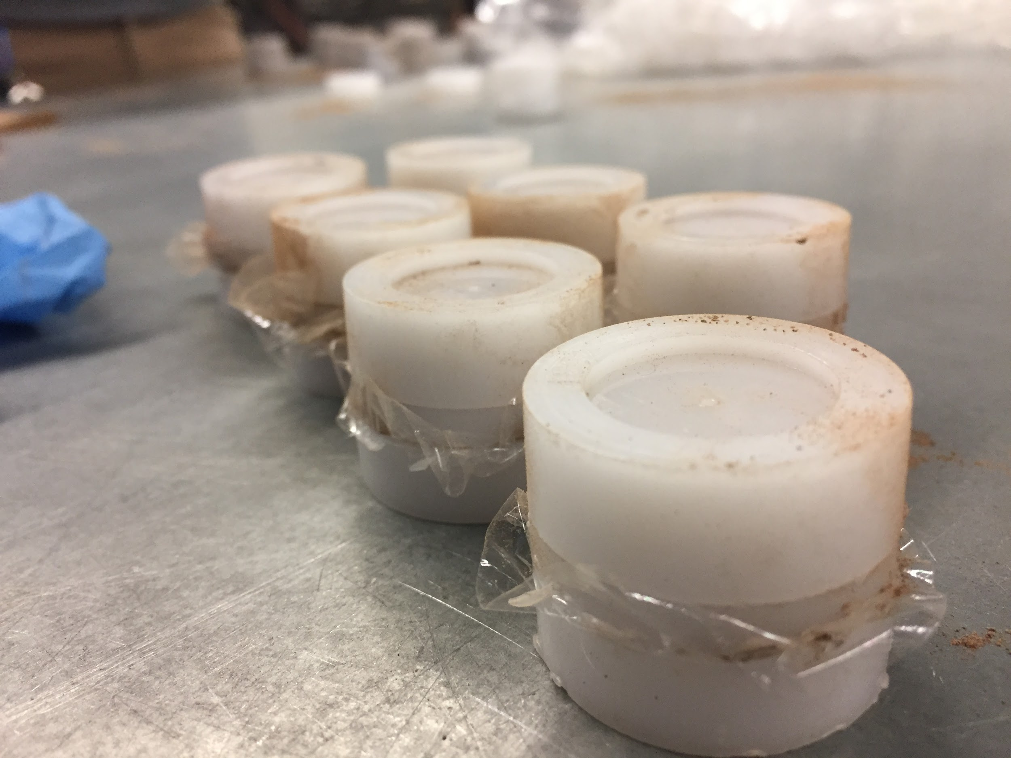
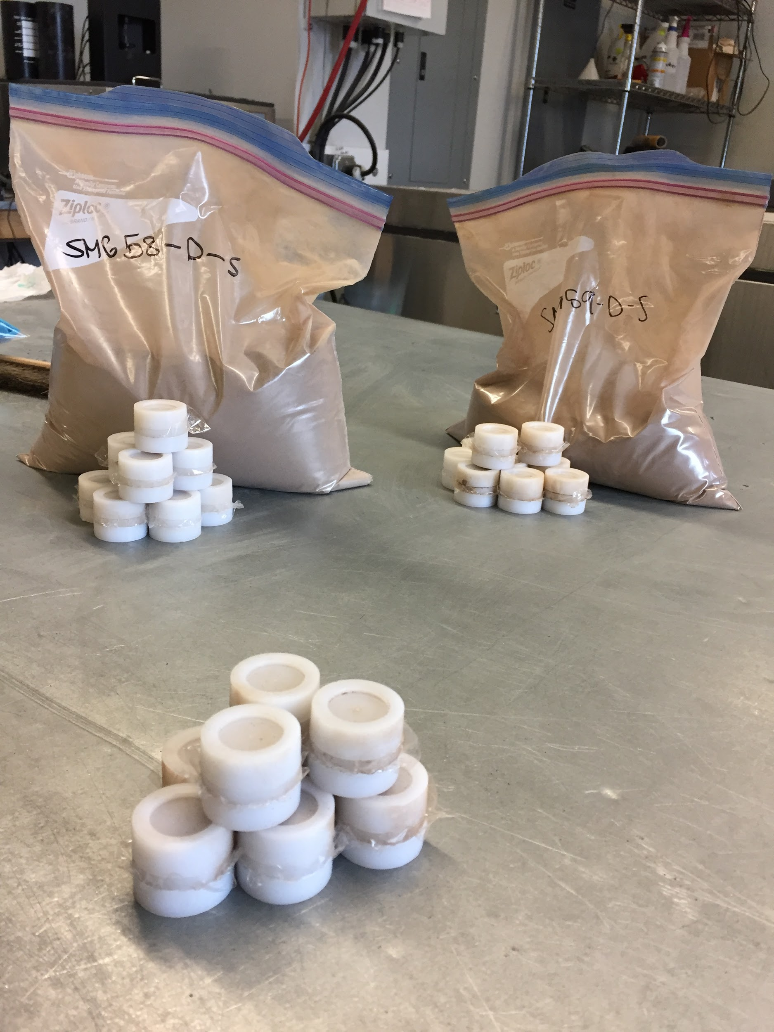
X-Ray Fluorescence Analysis
Figure 11. Sample Cups Prepared for Analysis
Figure 12. Sample Bags next to Finished XRF
7
Notes:
Maximum weight that these cups can hold is approx around 21 grams.
The inner size of the cups are about 23 mm.

Slide 9
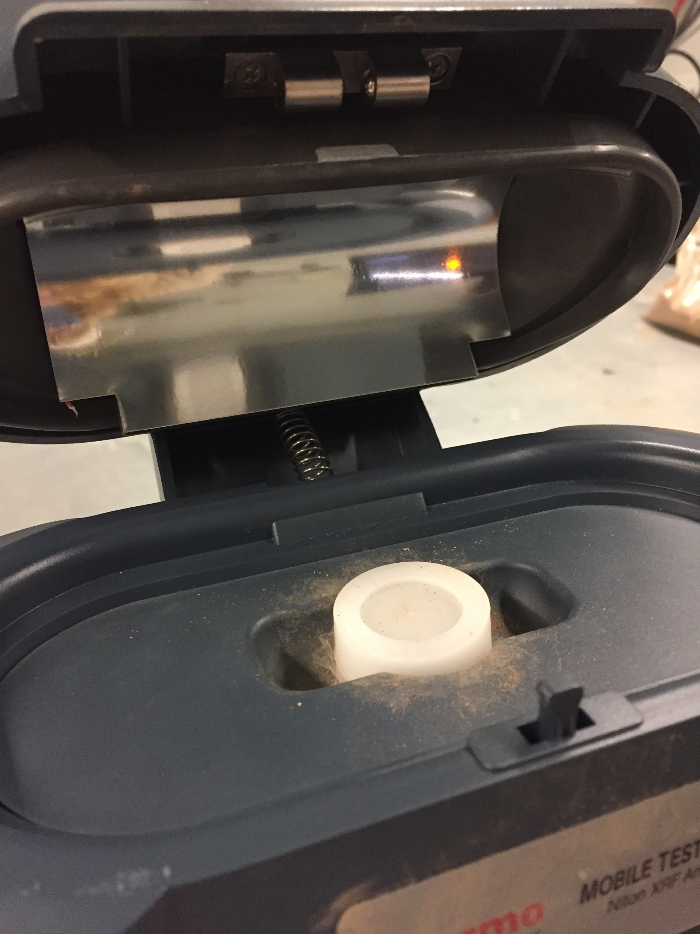
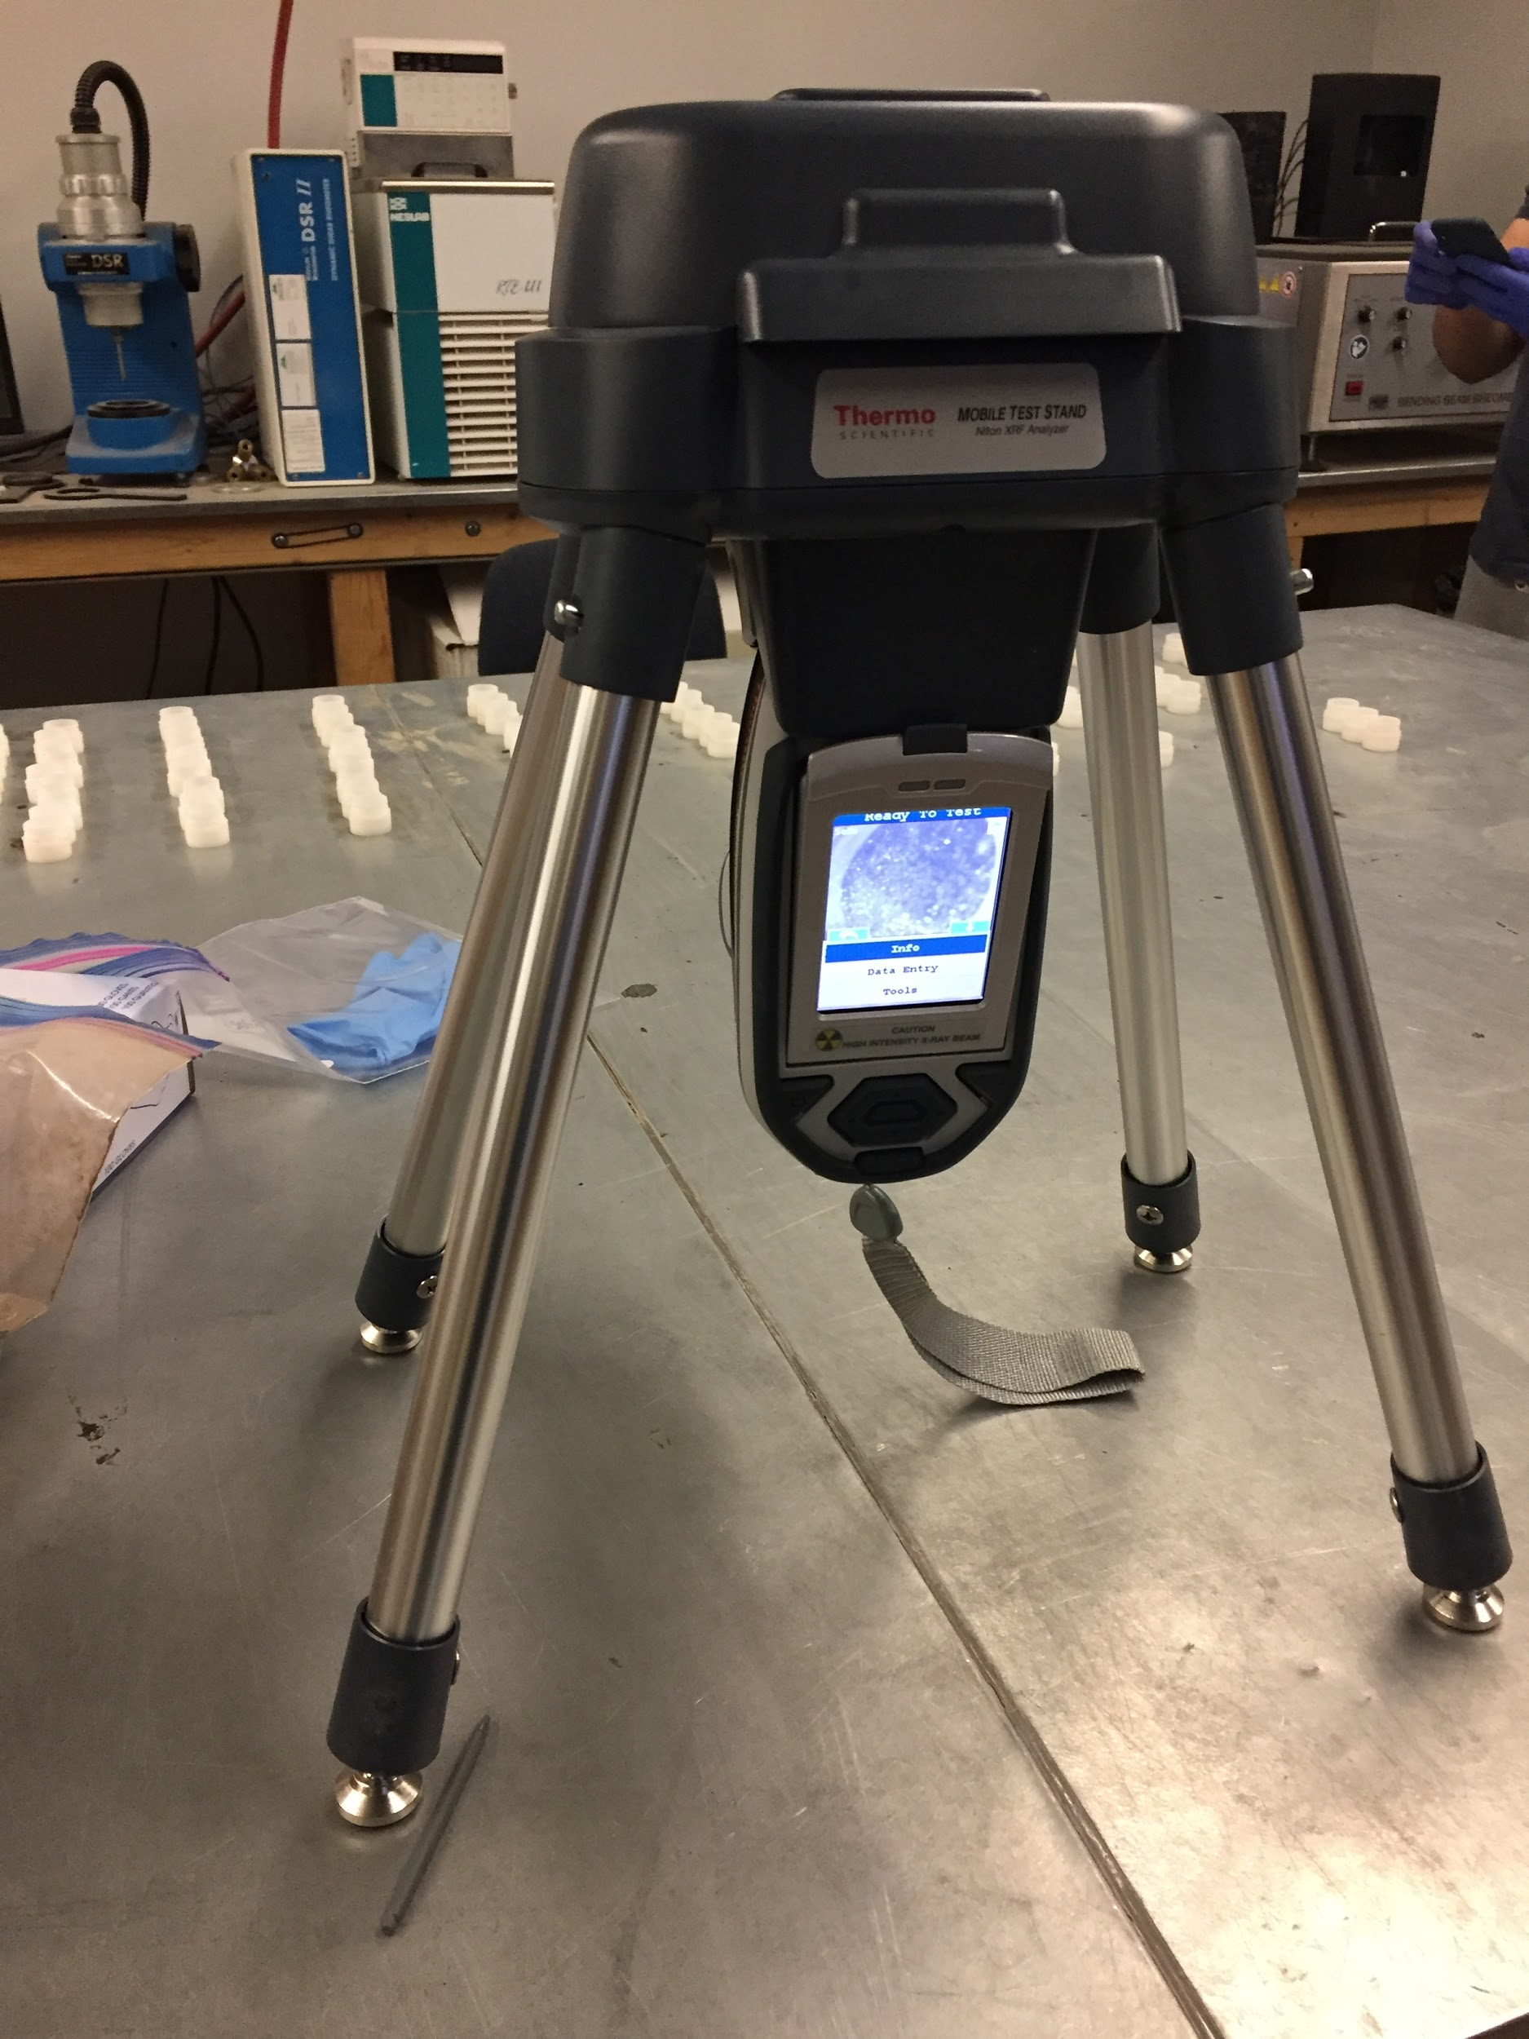
X-Ray Fluorescence Analysis
Figure 13. Sample Cup in the Stand Ready for Analysis
Figure 14. Mobile Stand used in Analysis
8
Notes:
I would include the other image that Angelina created with the arrows.

Slide 10
X-Ray Fluorescence Data
U – Uranium
Pb – Lead
As – Arsenic
Hg – Mercury
Zn – Zinc
Cu – Copper
Ni - Nickel
Table 1. XRF Data
Above AZ Non-Residential Soil Standards
Above AZ Residential Soil Standards
Residential: areas in which constant exposure occurs (neighborhoods)
Non-Residential: areas not intended for development
9

Slide 11
X-Ray Fluorescence Data
Fe – Iron
Mn – Manganese
V – Vanadium
Ba – Barium
Sb – Antimony
Sn – Tin
Cd – Cadmium
Ag - Silver
Table 2. XRF Data
Above AZ Non-Residential Soil Standards
Above AZ Residential Soil Standards
Residential: areas in which constant exposure occurs (neighborhoods)
Non-Residential: areas not intended for development
10

Slide 12
Contaminants of Concern
Human Health Risk
  Lead
  Arsenic
  Manganese
Ecological Health Risk
  Lead
  Zinc
  Copper
  Manganese
  Vanadium
  Nickel
  Barium
  Cadmium
  Silver
11

Slide 13
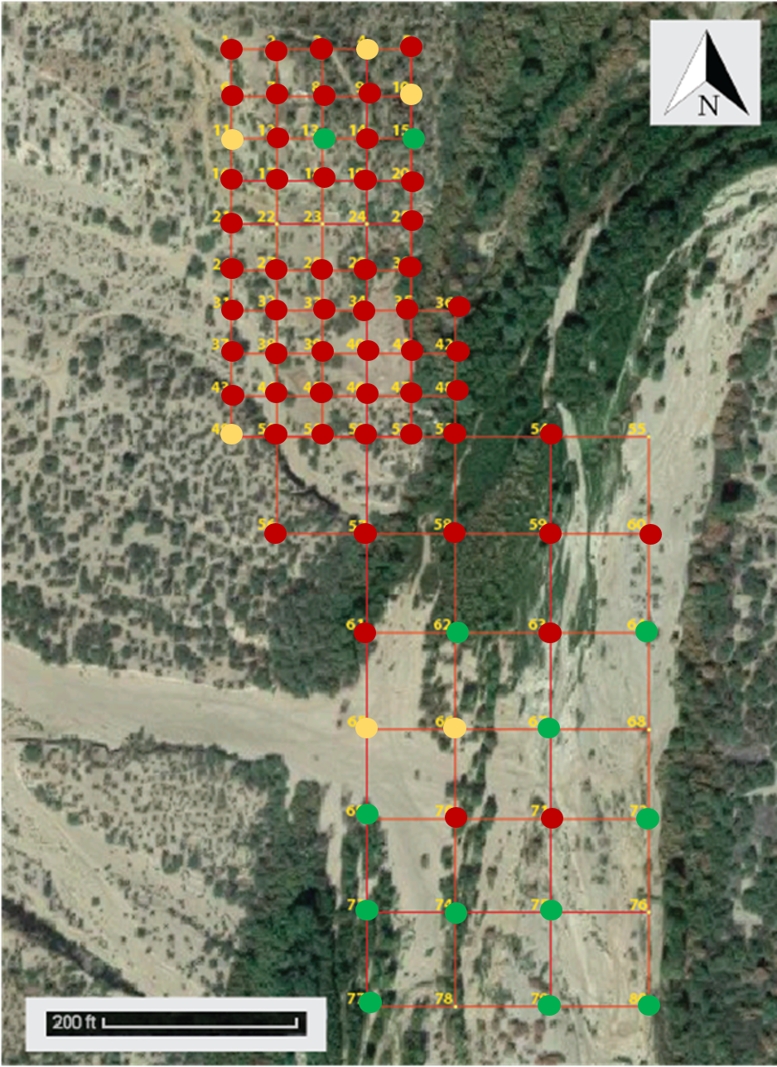

2,756 mg/kg of Lead
30,033 mg/kg of Lead
37 mg/kg of Lead
LEGEND
Above 800 mg/kg
400 mg/kg < X < 800 mg/kg
Below 400 mg/kg
Figure 15. Lead Concentrations (HH Criteria)
12

Slide 14
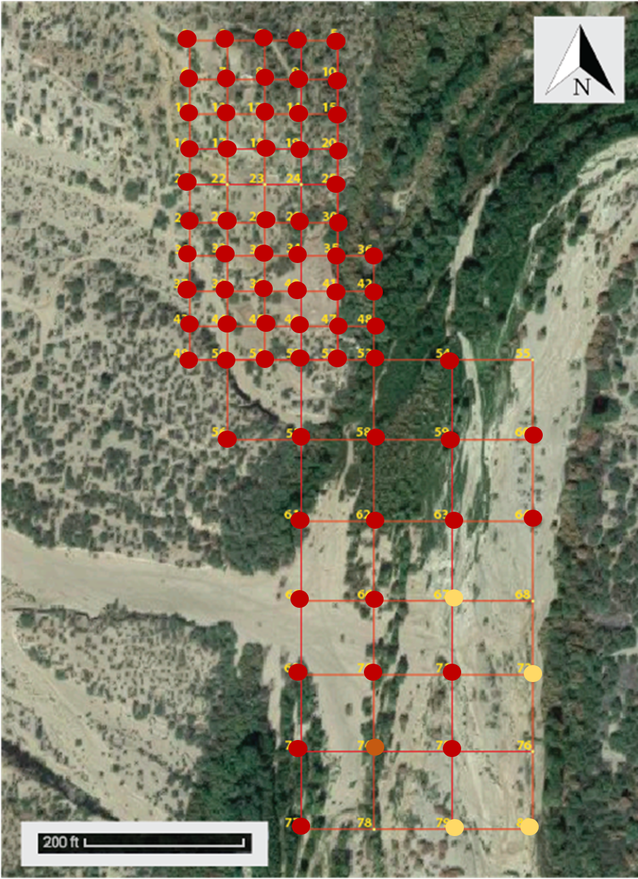

2,756 mg/kg of Lead
30,033 mg/kg of Lead
37 mg/kg of Lead
LEGEND
>120 mg/kg - affecting plants
>56 mg/kg - affecting mammals
>11 mg/kg - affecting avian wildlife
< 11 mg/kg – doesn’t affect any biota
Figure 16. Lead Concentrations (Eco Criteria)
13

Slide 15
Acid Digestion
Table 3. Organization of Choosing Samples for Digestion
Above AZ Non-Residential Soil Standards
Above AZ Residential Soil Standards
Samples Chosen for Acid Digestion
14

Slide 16
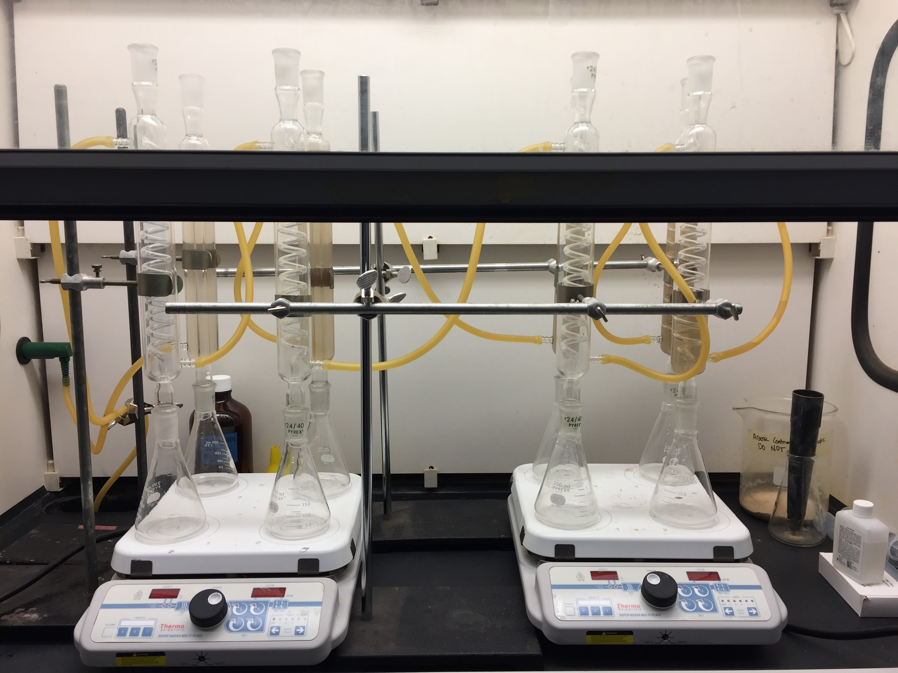
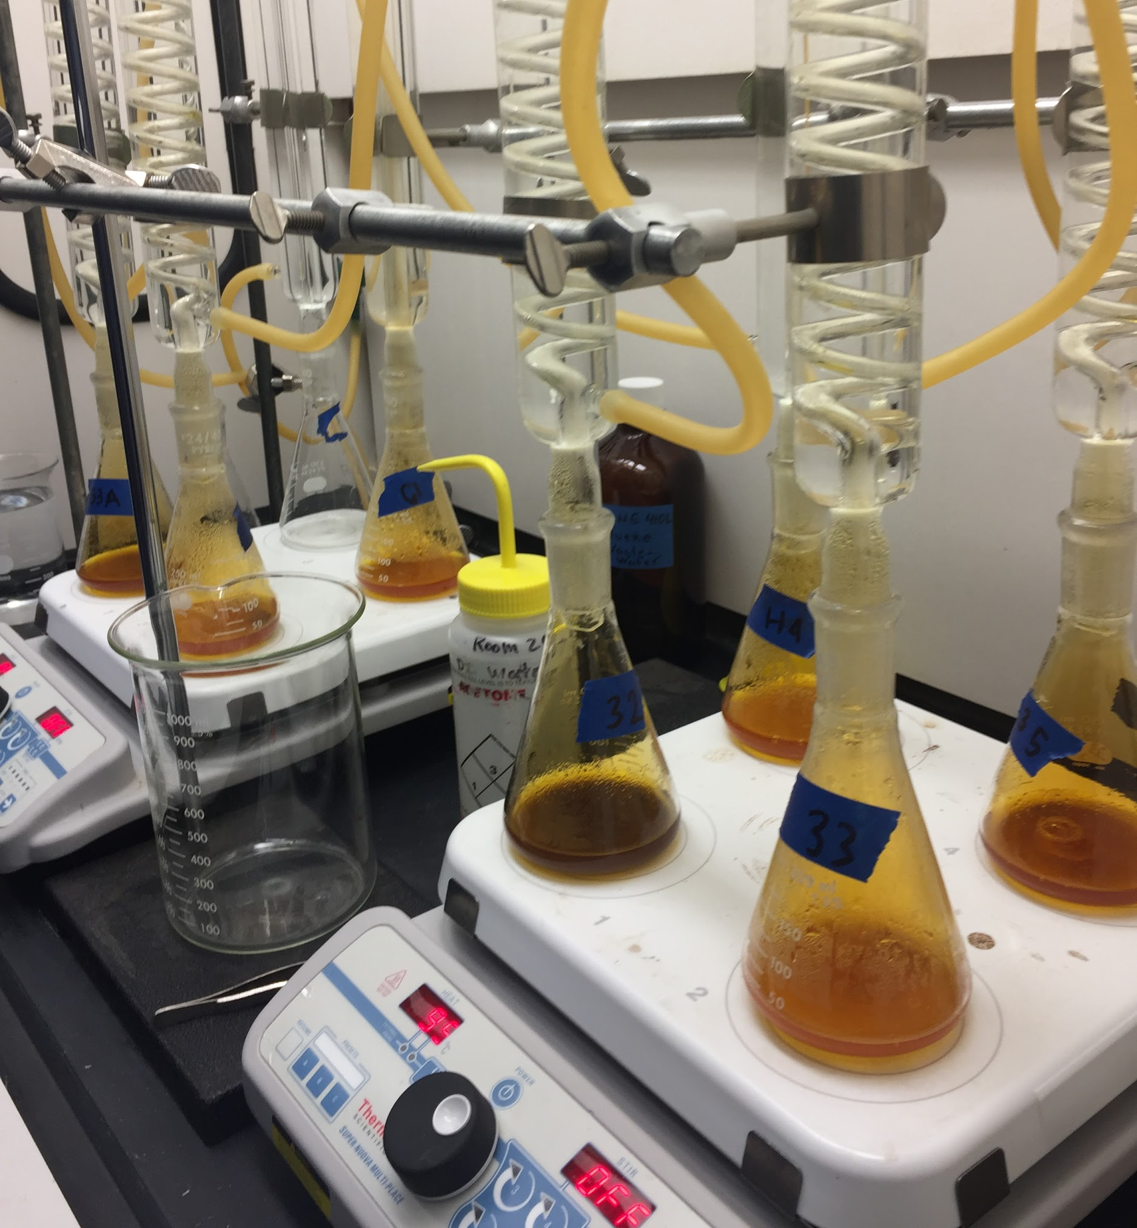
Acid Digestion
Figure 17. Setup for Acid Digestion in the Fume Hood
Figure 18. Acid Digestion of Samples
15

Slide 17
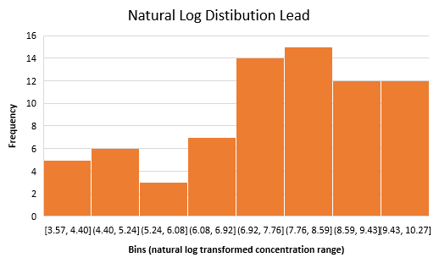
Data Correlation
Table 4. Contaminant Correlation Values
Contaminant | R-Value
Lead | 0.9859
Arsenic | 0.8387
Manganese | 0.9512
Table 5. 95% and 50% Exposure Point Concentrations (EPC)
Contaminant | 50% EPC (mg/kg) | 95% EPC (mg/kg)
Arsenic | 3.2 | 10.1
Manganese | 1662.5 | 3298.7
Lead | 2023.4 | 16425.6
Figure 19. Lead Natural Log Distribution
16

Slide 18
Human Health Risk Assessment
Most probable exposure scenarios:
Recreational (camping)
  Adult
  Child
  Exposure frequency: 14 days/year
  Exposure duration: 10 years
Worker
  Adult
  Exposure Frequency: 350 days/year
  Exposure duration: 1 year
Table 6. Ingestion Rates used for 50% and 95% Exposure Point Concentrations (EPC)
Scenario | Person | EPC | Ingestion Rate (mg soil / day)
Camping | Adult | 50% | 100
Camping | Adult | 95% | 100
Camping | Child | 50% | 200
Camping | Child | 95% | 200
Worker | Adult | 50% | 50
Worker | Adult | 95% | 100
17

Slide 19


Human Health Risk Assessment
HI: Hazard Index
(unitess)
CDI: Chronic Daily Intake (mg/[kg⋅day])
RfD: Reference Dose (mg/[kg⋅day])
CSF: Cancer Slope Factor ([kg⋅day]/mg)
Hazard Index
(Non-carcinogenic)
Cancer Risk
(Carcinogenic)
Hazard:
HI > 1
Used for:
Arsenic, Manganese
Hazard:
Risk > 10⁻⁶
Used for:
Arsenic
18

Slide 20

Human Health Risk Assessment
CDI: chronic daily intake (mg/[kg×day])
CS: chemical concentration in soil (mg/kg)
IR: ingestion rate (mg soil/day)
CF: conversion factor for soil 10⁻⁶ (kg/mg)
FI: fraction ingested
EF: exposure frequency (days/years)
ED: exposure duration (years)
BW: body weight (kg)
AT: averaging time (days)
Chronic Daily Intake
19
Notes:
Do we need?

Slide 21
Human Health Risk Assessment - Arsenic
Table 7. Arsenic Human Health Risk Assessment Results
Scenario | Person | CS | IR | CDI (mg/kg·day) | HI | Cancer Risk
Camping | Adult | 50% | 95% | 1.76E-08 | 0.000059 | 2.64 E-08
Camping | Adult | 95% | 95% | 5.53E-08 | 0.000184 | 8.30 E-08
Camping | Child | 50% | 95% | 7.56E-08 | 0.000249 | 1.12 E-07
Camping | Child | 95% | 95% | 2.35E-07 | 0.000783 | 3.52 E-07
Worker | Adult | 50% | 50% | 2.20E-06 | 0.007329 | 3.30 E-06
Worker | Adult | 95% | 95% | 1.38E-05 | 0.046119 | 2.08 E-05
CS – Concentration of Soil
IR – Ingestion Rate (mg soil/day)
CDI – Chronic Daily Intake (mg/kg·day)
HI – Hazard Index
20

Slide 22
Human Health Risk Assessment - Manganese
Table 8. Manganese Human Health Risk Assessment Results
Scenario | Person | CS | IR | CDI (mg/kg·day) | HI
Camping | Adult | 50% | 95% | 9.11E-06 | 0.0000651
Camping | Adult | 95% | 95% | 1.81E-05 | 0.0001291
Camping | Child | 50% | 95% | 3.86E-05 | 0.0002761
Camping | Child | 95% | 95% | 7.67E-05 | 0.0005477
Worker | Adult | 50% | 50% | 1.14E-03 | 0.0081338
Worker | Adult | 95% | 95% | 4.52E-03 | 0.0322773
CS – Concentration of Soil
IR – Ingestion Rate (mg soil/day)
CDI – Chronic Daily Intake (mg/kg*day)
HI – Hazard Index
21

Slide 23
Human Risk Assessment- Lead (Adults)
Table 9. Adult Lead Human Health Risk Assessment Results
CS – Concentration of Soil
EPC- Exposure Point Concentration
IR – Ingestion Rate (mg soil/day)
PbB- Lead Blood Concentration
Scenario | Person | EPC | CS (mg/kg) | IR (mg/day) | Risk
Camping | Adult | 50% | 2023 | 100 | 0.15%
Camping | Adult | 95% | 16426 | 100 | 23.37%
Worker | Adult | 50% | 2023 | 50 | 46.30%
Worker | Adult | 95% | 16426 | 100 | 100%
*Risk probability is based on exceeding 5 PbB μg/dl
22

Slide 24
Human Risk Assessment- Lead (Children)
Table 10. IEUBK Lead 50% EPC Human Health Risk Assessment Results
Table 11. IEUBK Lead 95% EPC Human Health Risk Assessment Results
Child Age Range (years) | Blood Pb (μg/dL)
0.5-1 | 3.0
1-2 | 2.6
2-3 | 2.3
3-4 | 2.2
4-5 | 2.0
5-6 | 1.9
6-7 | 1.8
Child Age Range (years) | Blood Pb (μg/dL)
0.5-1 | 12.9
1-2 | 11.5
2-3 | 10.1
3-4 | 9.7
4-5 | 9.4
5-6 | 9.0
6-7 | 8.4
23

Slide 25
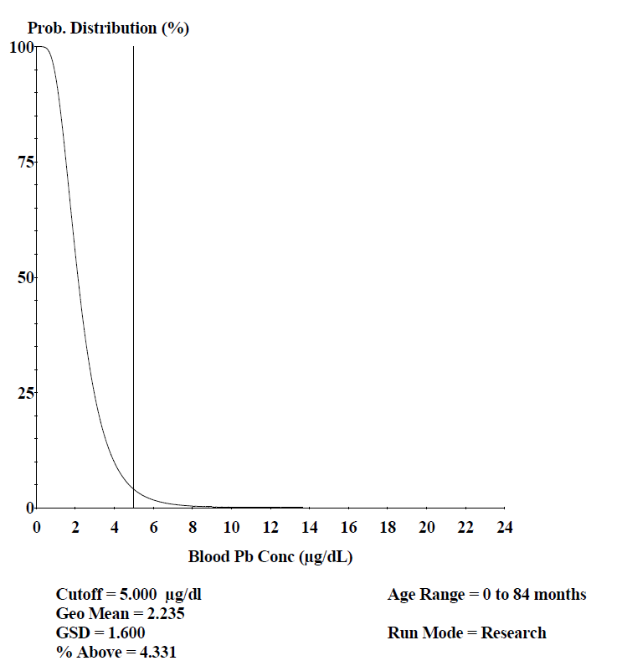
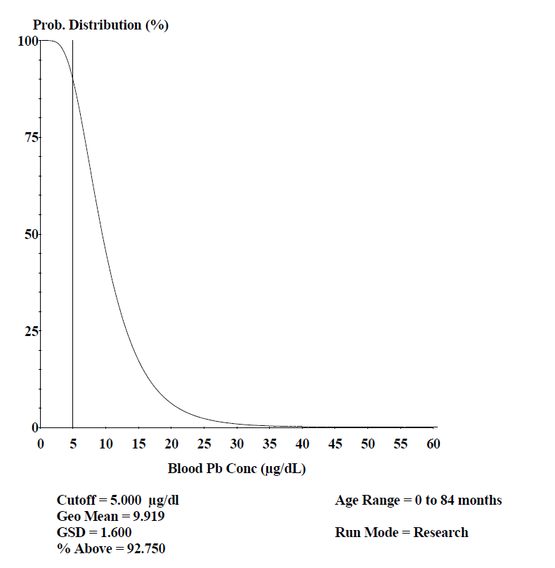
Figure 20. 50% EPC IEUBK Probability Distribution
Figure 21. 95% EPC IEUBK Probability Distribution
24

Slide 26
Ecological Risk Assessment
Table 12. Eco Contaminant Level Standards
Table 13. Samples Exceeding Contaminant Levels for Eco Risk
25
Notes:
Fix table to format like others, use average font

Slide 27
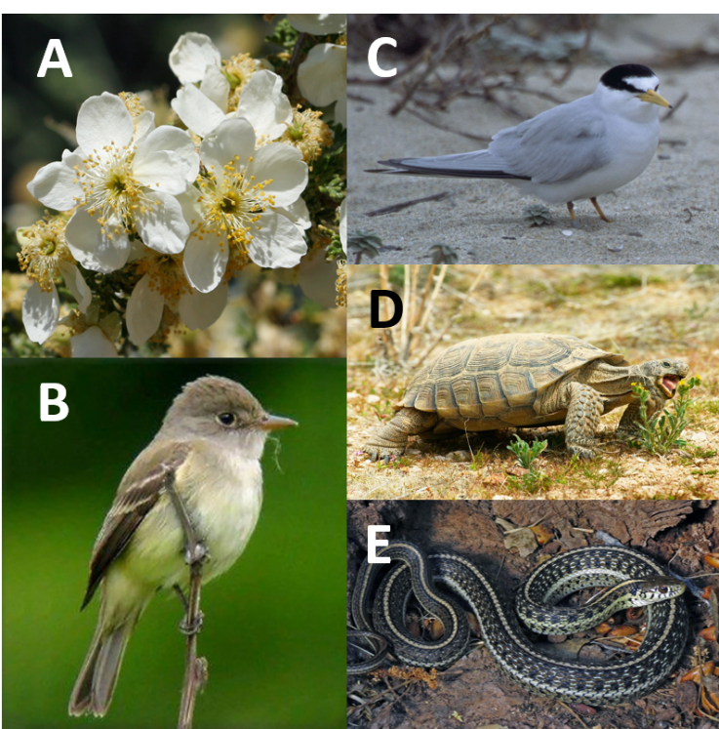
Ecological Risk Assessment
Endangered Species
A - Arizona Cliffrose
B - Southwestern Willow Flycatcher
C - California Least Tern
Threatened Species
D - Desert Tortoise
E - Northern Mexican Gartersnake
Figure 22. Native Animal Species
26

Slide 28
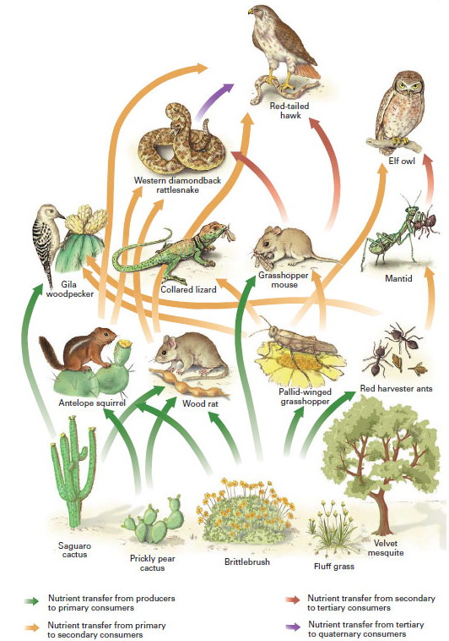
Ecological Risk Assessment
Bioaccumulation
  Plants uptake contaminated water flowing from the site
  Plants are the base of the food chain
Migration
  Site has a lot of hills
  Rainfall flows down towards Big Sandy
Figure 23. Desert Food Chain [3]
27

Slide 29
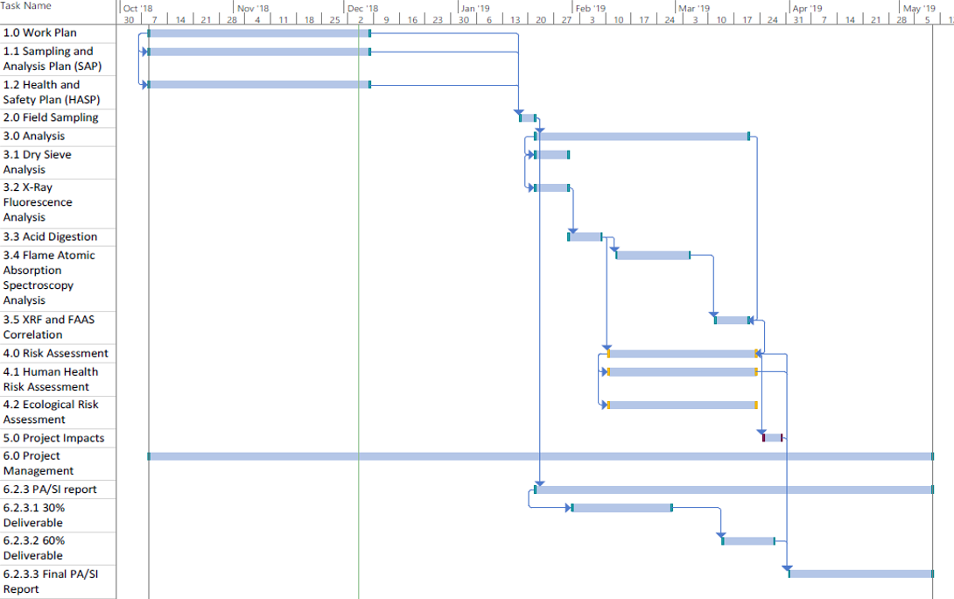
28

Slide 30
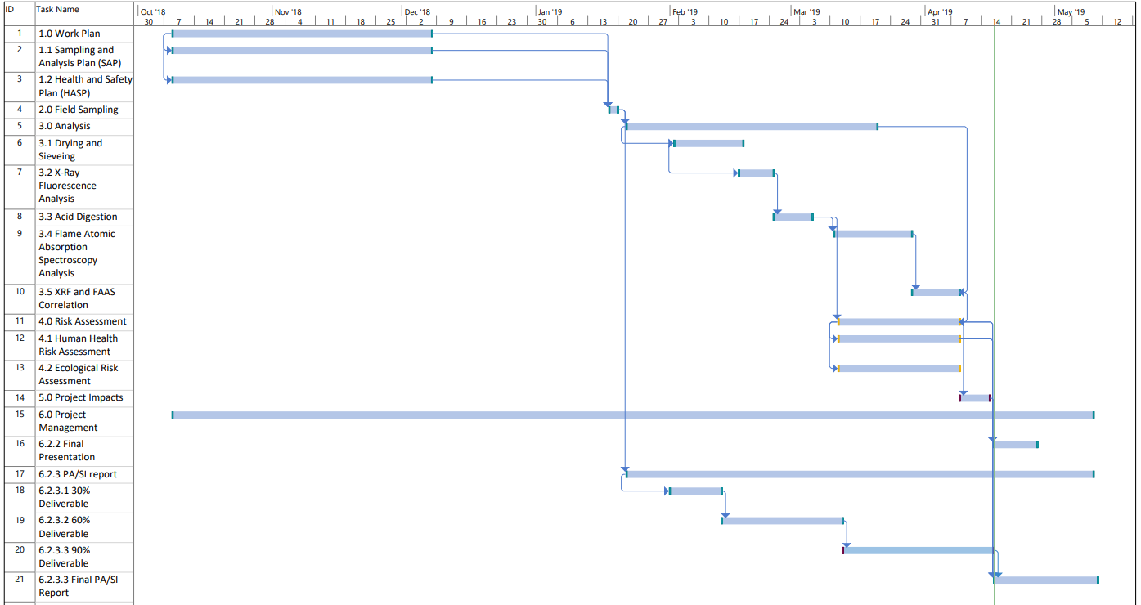
29

Slide 31
Project Hours
Table 14. Proposed hours spent over the course of the project
SENG - Senior Engineer
ENG - Professional Engineer
EIT- Engineer in Training
LAB – Laboratory Technician
Tasks | SENG | ENG | EIT | LAB
Task 1 Work Plan (Cumulative) | 8 | 24 | 24 | 0
Task 1.1. SAP | 4 | 12 | 12 | 0
Task 1.2 HASP | 4 | 12 | 12 | 0
Task 2. Field Sampling | 2 | 23 | 23 | 0
Task 3 Analysis (Cumulative) | 2 | 23 | 23 | 120
Task 3.1 Drying & Sieve Analysis | 0 | 0 | 0 | 40
Task 3.2 XRF Analysis | 0 | 0 | 0 | 40
Task 3.3 Acid Digestion | 0 | 0 | 0 | 16
Task 3.4 Data Correlation | 2 | 23 | 23 | 12
Task 4 Risk Assessment | 16 | 48 | 40 | 0
Task 4.1 Human Health Risk Assessment | 8 | 24 | 20 | 0
Task 4.2 Ecological Risk Assessment | 8 | 24 | 20 | 0
Task 5 Project Impact | 2 | 4 | 2 | 0
Task 6 Project Management (Cumulative) | 142 | 116 | 78 | 16
Cumulative Hours | 172 | 238 | 190 | 136
Sum of Hours | 736
30

Slide 32
Project Hours
SENG - Senior Engineer
ENG - Professional Engineer
EIT- Engineer in Training
LAB – Laboratory Technician
Table 15. Total Hours Spent Over the Course of the Project
Tasks | SENG | ENG | EIT | LAB
Task 1 Work Plan (Cumulative) | 11 | 21 | 20 | 0
Task 1.1. SAP | 5.5 | 10.5 | 10 | 0
Task 1.2 HASP | 5.5 | 10.5 | 10 | 0
Task 2. Field Sampling | 22.5 | 45 | 67.5 | 0
Task 3 Analysis (Cumulative) | 2.5 | 11.5 | 11.5 | 225
Task 3.1 Drying & Sieve Analysis | 0 | 0 | 0 | 60.25
Task 3.2 XRF Analysis | 1.5 | 8 | 9 | 100.25
Task 3.3 Acid Digestion | 0 | 0 | 0 | 64.5
Task 3.4 Data Correlation | 1 | 3.5 | 2.5 | 0
Task 4 Risk Assessment | 7.5 | 9.5 | 5.5 | 0
Task 4.1 Human Health Risk Assessment | 6.5 | 7.5 | 2.5 | 0
Task 4.2 Ecological Risk Assessment | 1 | 2 | 3 | 0
Task 5 Project Impact | 4 | 3 | 0 | 0
Task 6 Project Management (Cumulative) | 78.5 | 68 | 55 | 0
Cumulative Hours | 126 | 158 | 159.5 | 225
Sum of Hours | 668.5*
*Under by 67.5 hours
31

Slide 33
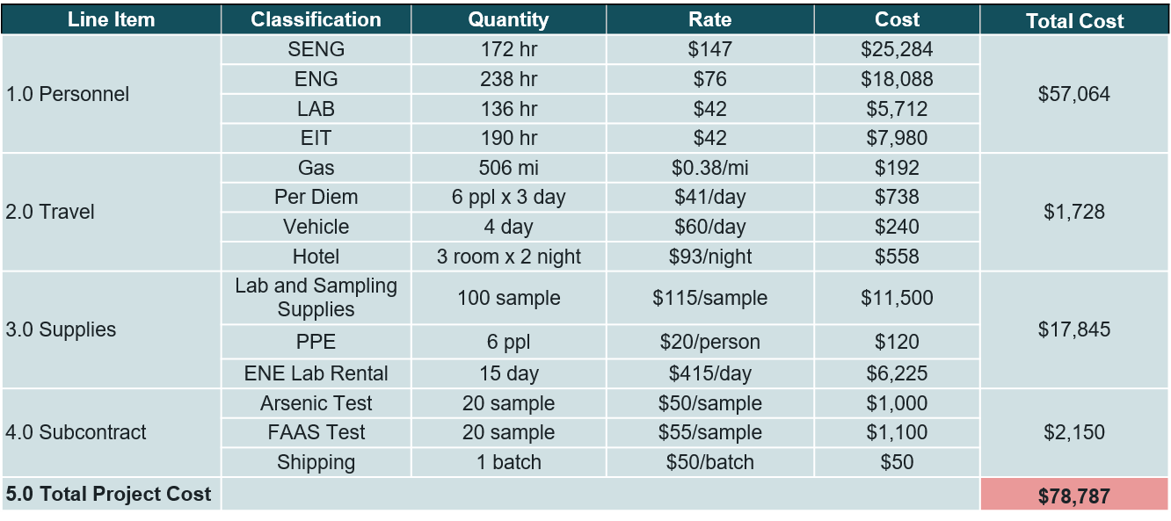
Cost of Engineering Services
Table 16. Original Cost Estimate for the Project
32

Slide 34
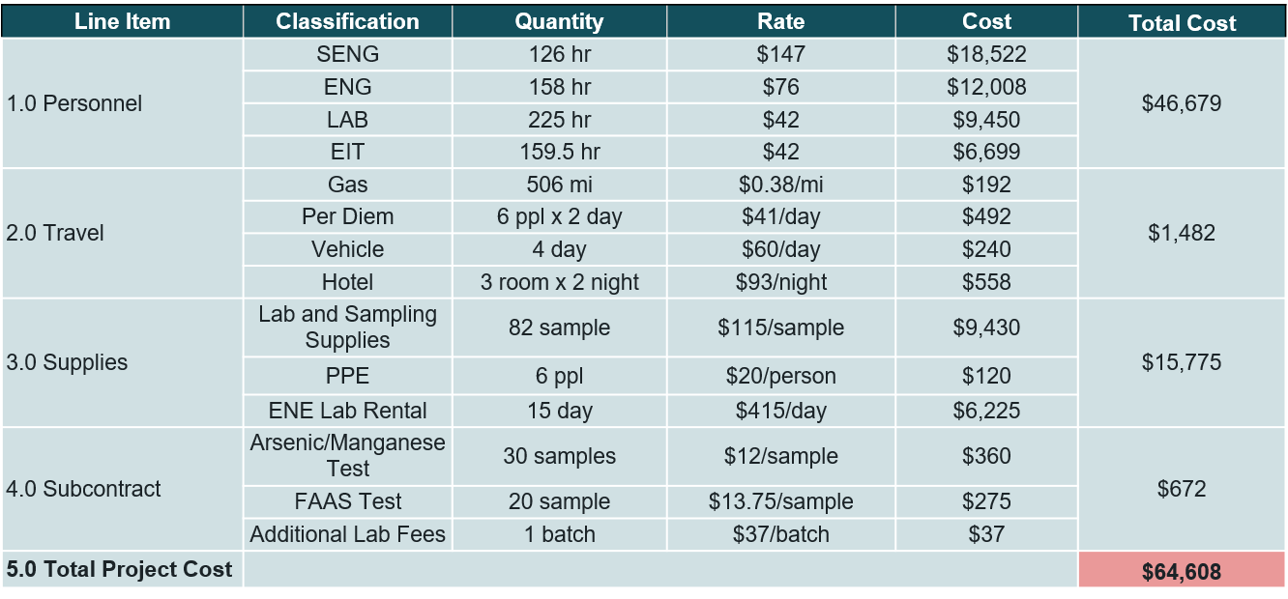
Cost of Engineering Services
Table 17. Total Cost of Engineering Services for the Project
33

Slide 35
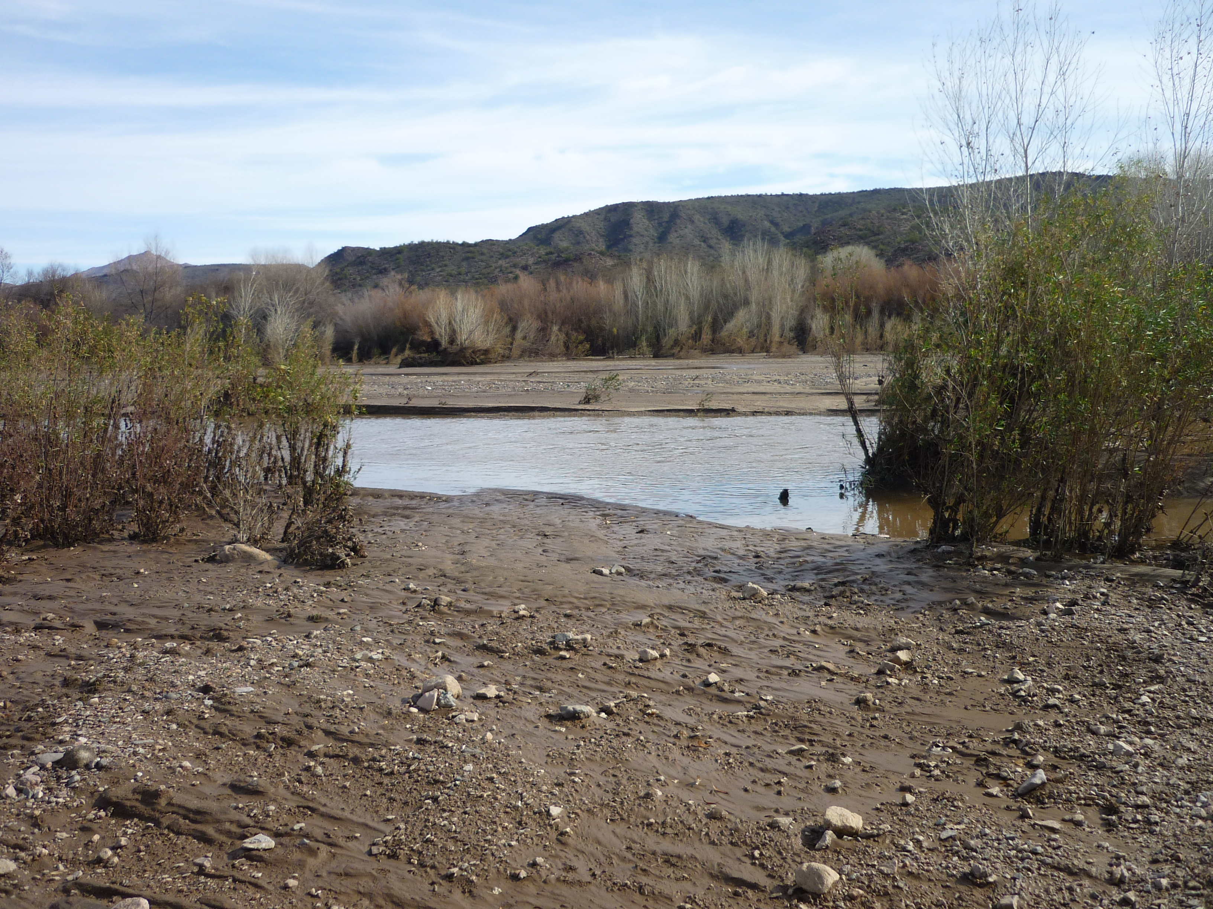
Project Impacts
Economic
  If remediation occurs, tax payer money would help fund the project
  Create new jobs for remediation
Environmental
  Ecological risk present
  If remediated, migration down the Big Sandy River would be mitigated
Social
  Recreational users are affected by lead contamination on site
Figure 24. Big Sandy River
34

Slide 36
References
[1] U.S. EPA. “EPA Method 200.8: Determination of Trace Elements in Waters and Wastes by Inductively Coupled Plasma-Mass Spectrometry” Washington, DC. 2007
[2] U.S. EPA. “ SW-846 Test Method 6200: Field Portable X-Ray Fluorescence Spectrometry for the Determination of Elemental Concentrations in Soil and Sediment,” Washington, DC. 2007
[3] Northern Arizona University. Desert Food Chain. Available: https://www2.nau.edu/lrm22/lessons/food_chain/food_chain.html
35

Slide 37
Figure 25. Lead Correlation Data
36

